Slide 1
Health Insurance Claims Report
ISM 6218 Advanced Database Management Systems
Prof. Don Berndt
Group Members
Shreyas Thombare
Adarsh Patel
Ninad Mehta
Vanshika Parihar
Zima Patel

Slide 2
Contents
Executive Summary
Problem Statement
Project Evaluation
Database Design
Query Writing
Performance Tuning
Data Visualizations
Summary
References

Slide 3
Executive Summary
In this project our main goal is to extract reports for the healthcare insurance officials which can enable them to analyse and present insights to the mangeorial officials.
We generated our own dataset which had 7 tables (described in the further sections).
We formulated a relational database using MySQL Workbench and populated all 7 tables with approximately 100 rows each table.
In order to optimize our query performance we utilized power of indexing, partitioning, stored procedures and views in our project.
In addition to generating queries we coupled tableau with our Healthcare Insurance Claims database and developed interactive visualizations.

Slide 4
Questions To Ponder/Problem Statement
Reporting top 20 members along with provider details, billed amount and approved amount associated and having approved_amount greater than $2200
Reporting distinct members (member demographic information) who have their claims in progress.
Finding member subscribed to a coverage plan having address ID between 2000 to 5000

Slide 5
Project Evaluation
Topic Area | Description | Points
Database Design | We worked on designing the ER diagram which depicted the relationship among the tables using MySQL WorkBench | 25
Query Writing | We formulated queries using joins, where clause and between clause to address 4 vital questions | 30
Performance Tuning | We used views, stored procedure, and indexing to optimize scalability and lower the overhead. | 30
Other Topics | We connected MySQL to Tableau and designed interactive visualizations. | 15

Slide 6
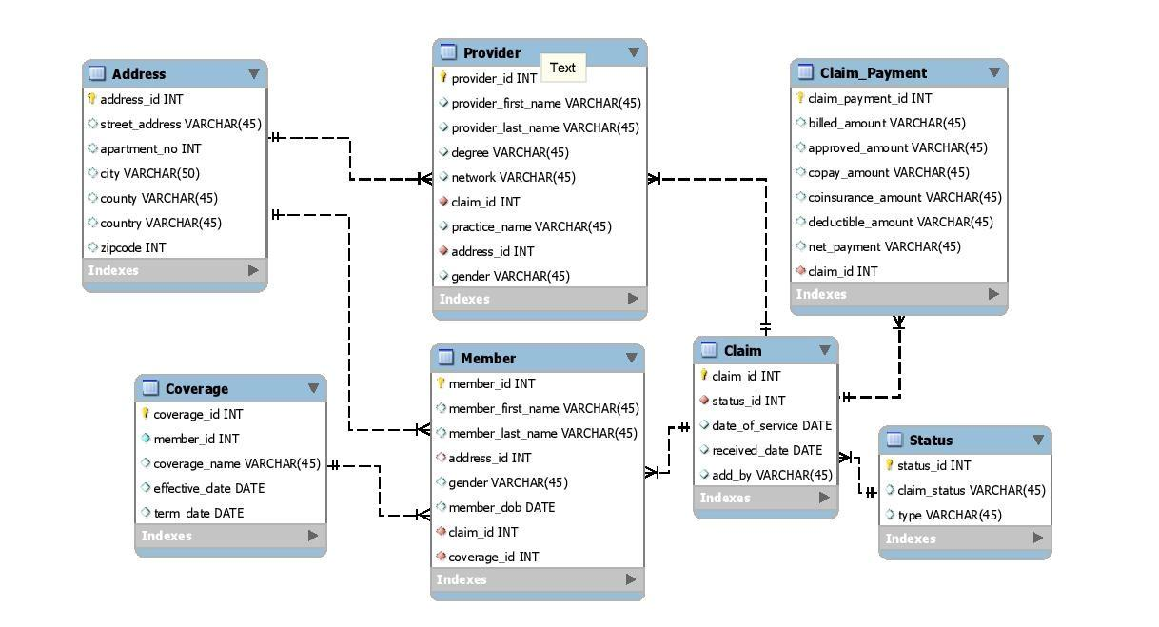
Database Design

Slide 7
Database Design
Table Name | Primary Key | Foreign Key
Provider | provider_id | claim_id(claim) address_id(address)
Member | member_id | address_id(address) claim_id(claim) coverage_id(coverage)
Claim | claim_id | status_id(status)
Claim_Payment | claim_payment_id | claim_id(claim)
Coverage | coverage_id | member_id(member)
Status | status_id
Address | address_id

Slide 8
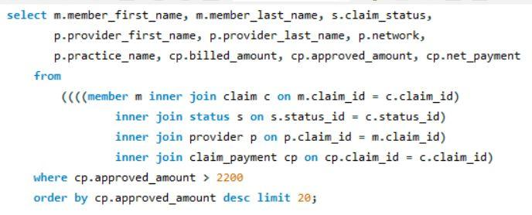
Query Writing
Reporting top 20 members along with provider details, billed amount and approved amount associated and having approved_amount greater than $2200.

Slide 9
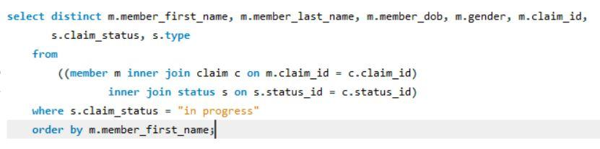
Query Writing
2) Reporting distinct members (member demographic information) who have their claims in progress.

Slide 10

Query Writing
3) Finding member subscribed to a coverage plan having address ID between 2000 to 5000

Slide 11
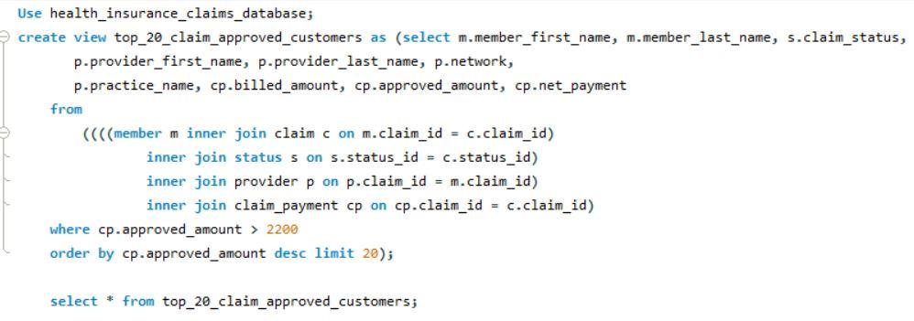
Performance Tuning
Using Virtual Tables

Slide 12
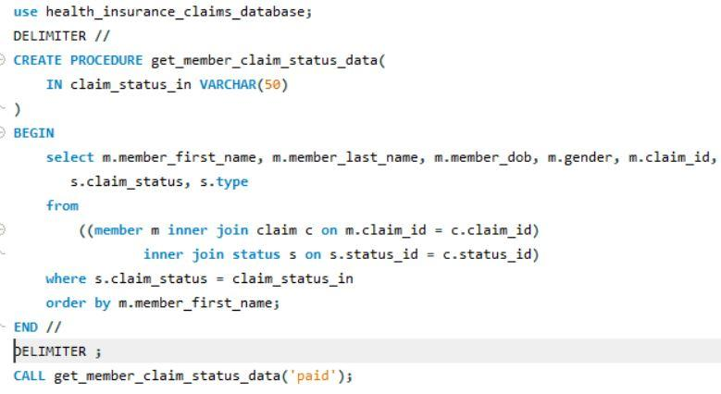
Performance Tuning
2) Using Stored Procedures

Slide 13
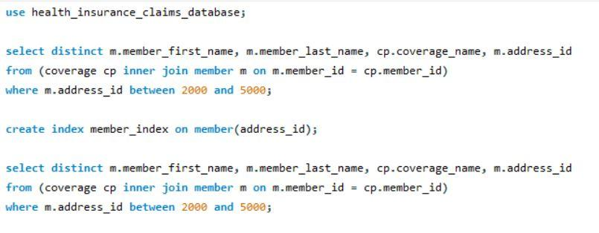
Performance Tuning
3) Use of Indexes for optimizing table searches

Slide 14
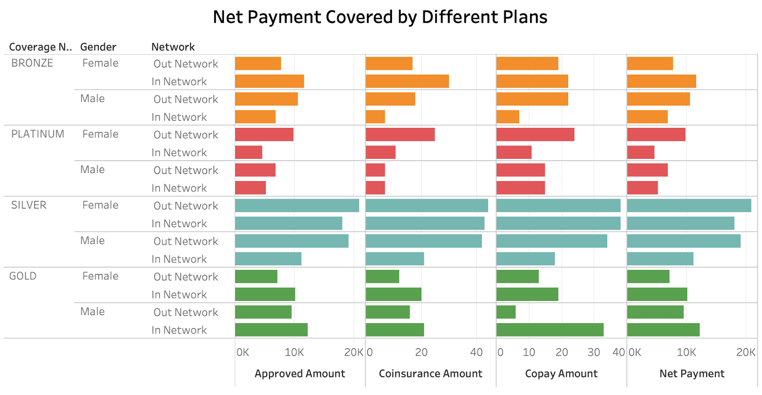
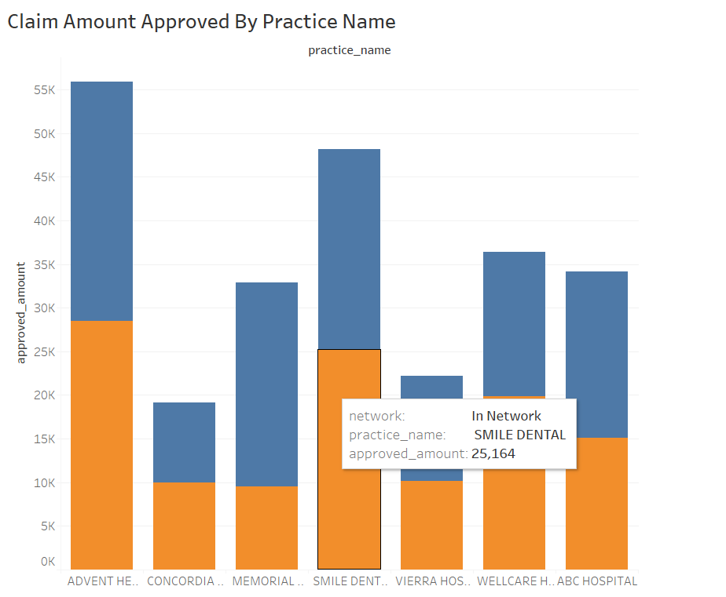
Data Visualization

Slide 15
Summary
This project can be utilized as a reporting model by a variety of target audiences such as health insurance companies, facilities and physicians.
This project helped us to dive deep into the business domain of medical insurance. Apart from the insurance industry we also focussed on medical facilities datasets which helped us to extract insights from the medical field.
Considering the future scope of the project, we would like to extend this system by formulation transactions and triggers.
Integrating MySQL with Tableau enabled us to analyse real time data on the go and develop interactive visualizations

Slide 16
References
https://money.usnews.com/money/personal-finance/family-finance/articles/2018-10-18/7-factors-to-consider-when-shopping-for-health-insurance
https://www.sisense.com/blog/8-ways-fine-tune-sql-queries-production-databases/
https://www.sqlshack.com/query-optimization-techniques-in-sql-server-the-basics/
https://dataschool.com/sql-optimization/how-indexing-works/

Slide 17
Thank you

